Slide 1
Salesforce Partner Cloud + Structured
Delivering End-to-End Partner Management, Activation & Execution

Slide 2
Agenda
Meet the Team
1
Structured Intro
2
Structured Demo
3
Resources
4
Q&A
5
Notes:
CHRISTINA
A — Acknowledge the Time
“It’s been awesome working with Mike, Derrick, Steve, and John over the past few months to bring Structured and Partner Cloud together.Thanks everyone for making the time today — I know you’re busy, especially closing out the year with your customers looking for ways to grow partner revenue.
C — Confirm the Agenda
“Today, we’ll cover:
A simple overview of who Structured is.
How we complement Salesforce Partner and core clouds.
A clear picture of when to bring us into your customer opportunities.”
E — End in Mind
We’d like to keep this interactive - please interrupt with any questions. With that being said, let’s kick it off.

Slide 3





Meet the Team
Steven Kellam
Christina Fail
Sam Oliff
Nat Pestereva
Brian Dudley
Chief Revenue Officer
Dir. of Alliances
GTM, East
GTM, Mid Market
GTM, West
Escalation owner and program leadership across all initiatives.
Primary contact for strategy, alliances, and ecosystem alignment.
Drives GTM and revenue growth for $1B+ accounts east of the Mississippi.
Leads GTM and sales coverage for $100M–$1B accounts.
Leads GTM and revenue growth for $1B+ accounts west of the Mississippi.
Notes:
CHRISTINA
Some quick intros…and I mean quick ;)
I’m Christina Fail, Director of Alliances. I oversee our strategic partnerships and all things ecosystem, and I’ll be your go-to person for anything related to our partnership.
Steven… (then Sam, Nat and Brian).

Slide 4
Structured is purpose‑built to help vendors and their partners accelerate GTM, drive demand generation & scale revenue.
Notes:
Let’s start with the big picture.
For 26 years, Structured has helped channel leaders/marketers simpliFY execution, scale partner impact, and prove results.
We work with teams at companies like Microsoft, Google, ServiceNow, and Dell —
but the challenges are consistent across the board: too many tools, low partner engagement, slow campaign execution, and no clear ROI.
What we’ve built is a platform that combines automation and AI to help partners take GTM action —
quickly, consistently, and in a way that actually drives revenue.
Today, we’re going to show you how we help customers move from content distribution to real partner activation.

Slide 5
Where Structured Can Add Value
Vendors struggle to consistently activate partners with scalable, turnkey marketing.
Salesforce Partner Cloud customers often need a simple way to execute co-marketing.
Vendor ecosystem growth accelerates when co-marketing becomes efficient and repeatable.
Notes:
What we’re seeing across the ecosystem is simple: vendors want to drive more partner-led demand, but partners often don’t have the time, skills or tools to easily execute campaigns.
Salesforce PRM gives them the foundation… & Structured adds the execution layer that makes co-marketing easy, scalable, and repeatable.
Together, we can help your customers activate partners and generate more pipeline, faster.

Slide 6
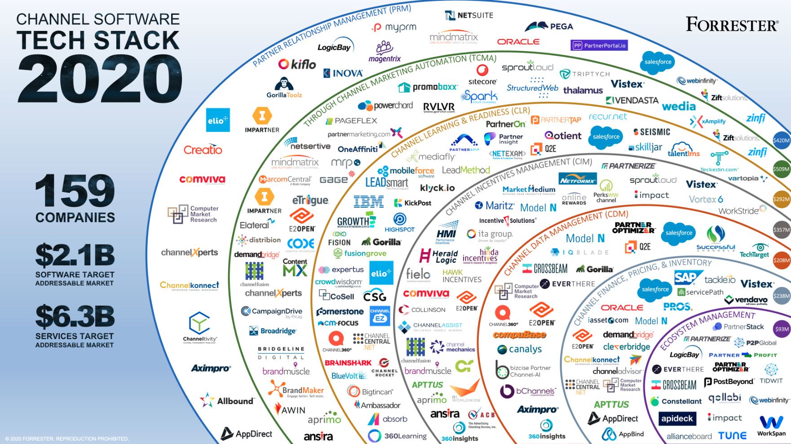
HighLevel Statement TCMA - PMAP -Just Ask
Vendors struggle to consistently activate partners with scalable, turnkey marketing.
Salesforce Partner Cloud customers often need a simple way to execute co-marketing.
Vendor ecosystem growth accelerates when co-marketing becomes scalable and repeatable.
Through-channel marketing automation (TCMA) — Enables partners to engage their customers with a consistent vendor brand experience to create awareness and generate demand.
Notes:
Derrick asked me to talk briefly about the history of TCMA, where it stands today, and where it's headed….
Partner marketing has evolved from basic TCMA, where partners pulled static content and templates, to modern Partner Marketing Automation Platforms (PMAP), where campaigns are automated and highly personalized.
But the next frontier is even simpler — what we call ‘Just Ask.’ Partners will be able to ask for what they need and instantly generate campaigns, content, and journeys powered entirely by AI. No setup, no templates, no tagging, no metadata — just outcomes.

Slide 7
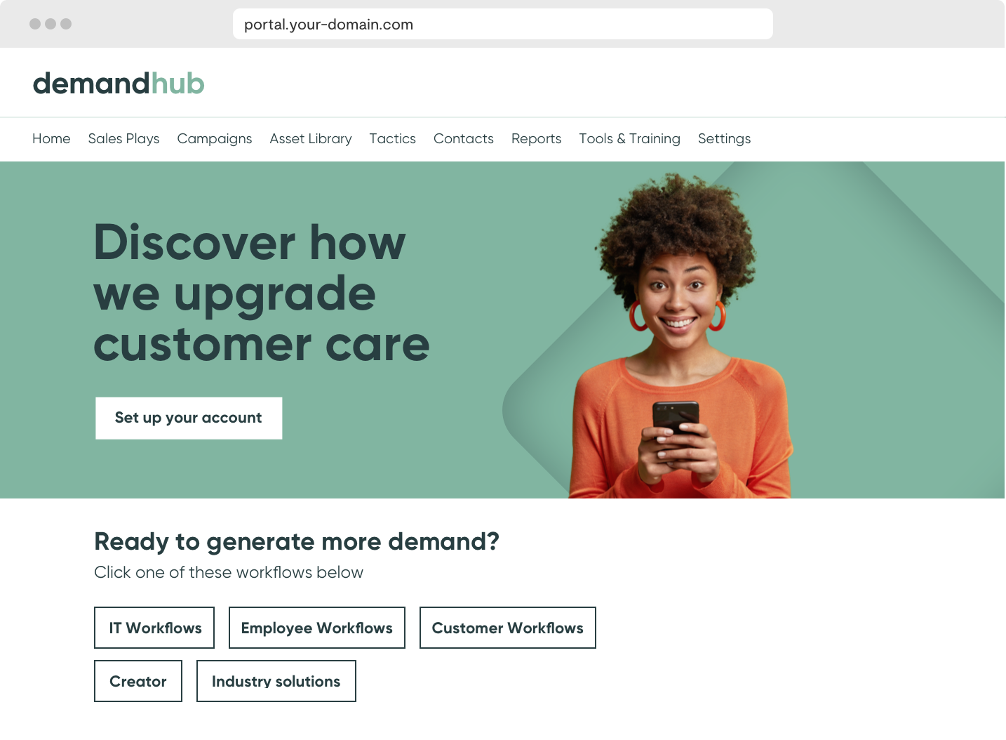

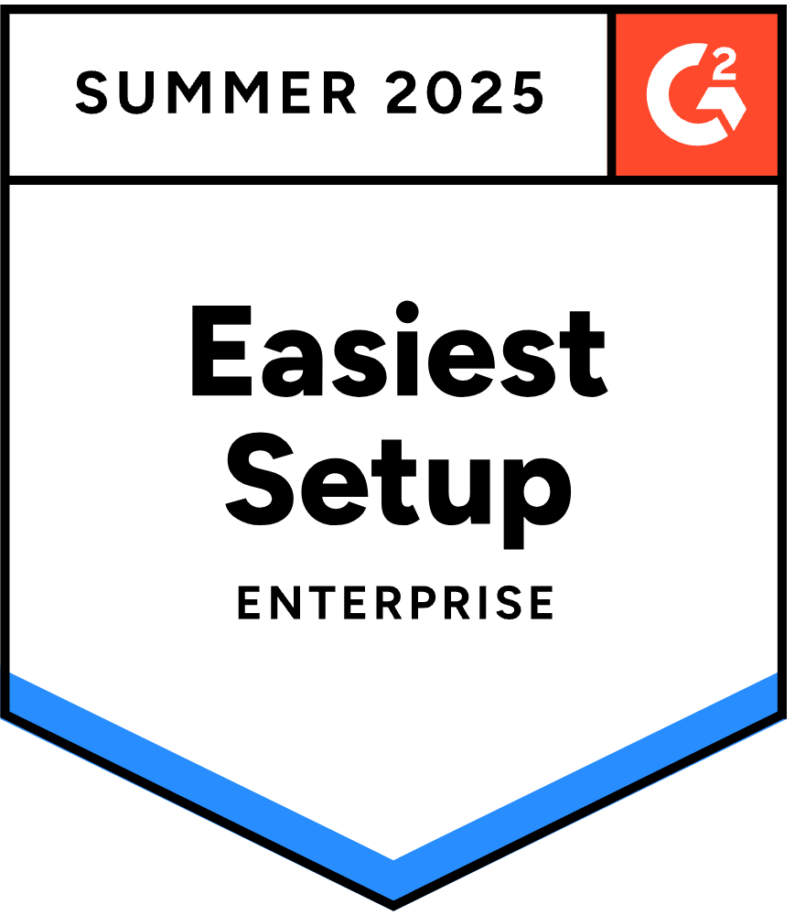
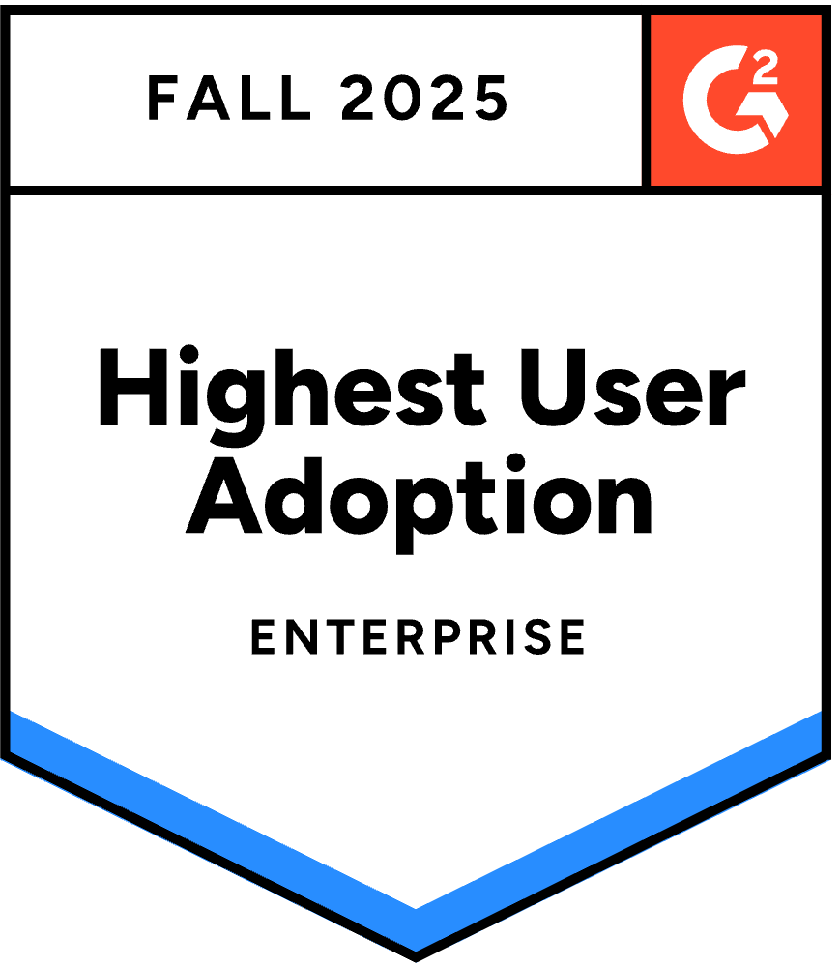

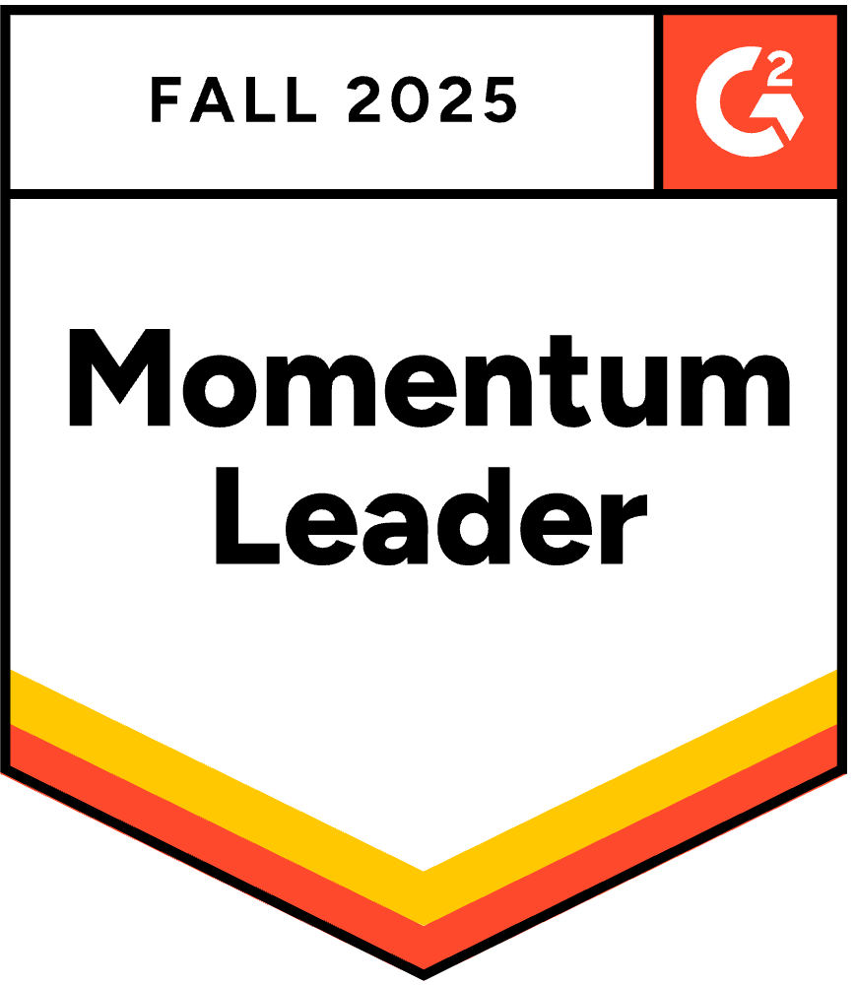
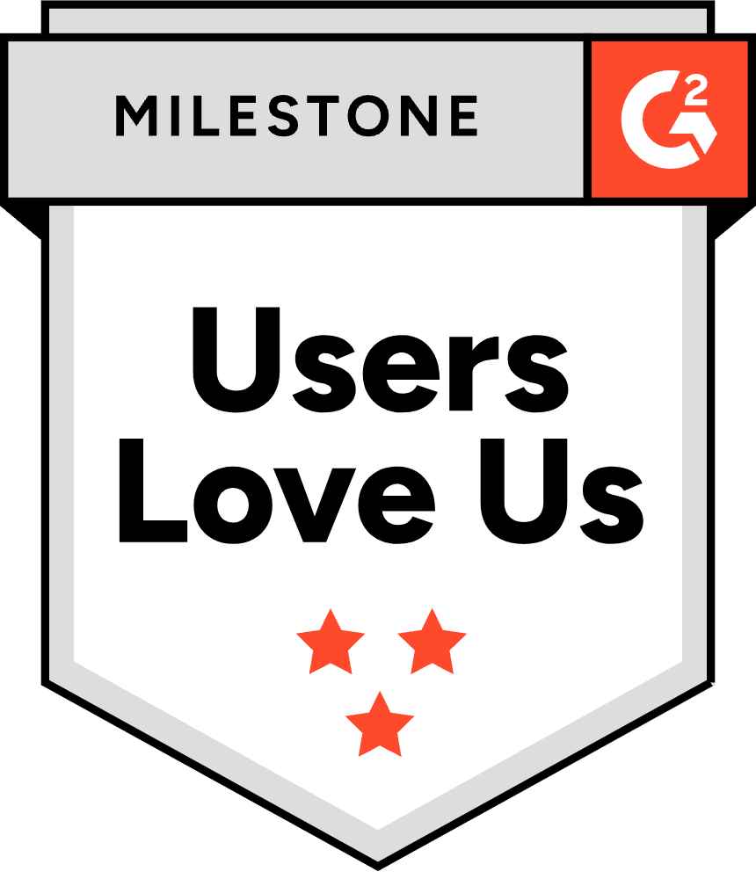
Structured: At a Glance
PARTNER DEMAND GEN ENGINE
Creates scalable partner campaigns that consistently generate measurable pipeline.
CONTENT PERSONALIZATION
Instantly transforms vendor content into localized, personalized partner-ready marketing.
UNIFIED EXECUTION
Centralizes global partner marketing to ensure consistent activation and attribution.
Notes:
“First, we’re a Partner Demand Engine. We’re the number one partner marketing automation platform in the Forrester Wave, and our focus is helping vendors actually drive partner-led demand.
“Second, we bring AI-powered content personalization. Partners can create personalized, compliant, multilingual content in seconds. It removes friction, and it’s why partners actually launch campaigns instead of just downloading assets.
“And third, Structured acts as the unified execution layer for global ecosystems. We sit right on top of Partner Cloud, so vendors get one consistent way to activate thousands of partners across hundreds of countries. Content, programs, and data all flow together, with full analytics and ROI tracking. It gives your customers the management layer and the execution engine in one combined experience.”

Slide 8
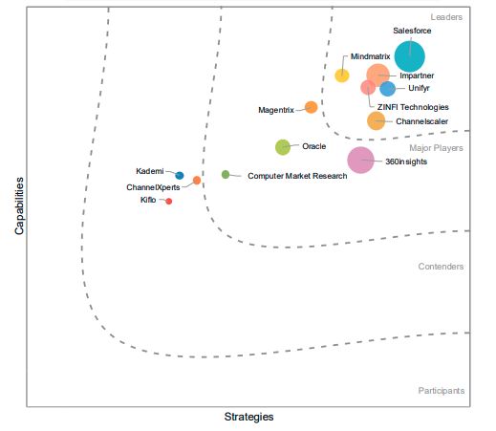
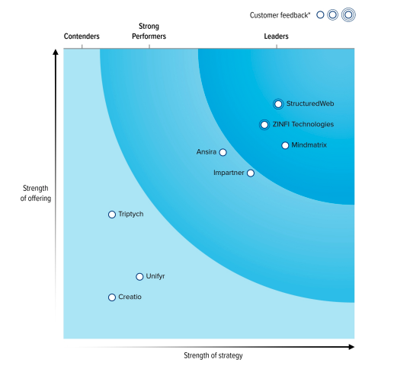
Better Together
IDC MarketScape: Worldwide PRM Applications ‘25-’26
Forrester Wave™: Partner Marketing Automation Platforms, Q2 ‘25
Notes:
Think about it. Salesforce already leads in PRM, as you can see on the left and know. And Structured leads in partner marketing automation per Forrest, as shown on the right.
Together, this gives your customers the best of both worlds… Salesforce for partner management and Structured for partner demand creation.
It’s a complementary story that strengthens your ecosystem and helps vendors activate partners and generate more pipeline.

Slide 9
Better Together
IDC MarketScape: Worldwide PRM Applications ‘25-’26
Forrester Wave™: Partner Marketing Automation Platforms, Q2 ‘25
Notes:
And this is why we should really collaborate. Everyone else in the TCMA/PMAP space competes with Salesforce! We have:
No overlap with your PRM, CRM, or PEM products.
And unlike Zinfi, Mindmatrix, Impartner and Unifyr, we do not cannibalize Salesforce revenue.
We are the execution engine, not the system of record — perfectly complementary.

Slide 10




















Market Leading Demand Generation Capabilities
Channel AI AI tools to create, localize, and launch campaigns faster across partners with less effort.
Assistant UI
Campaign AI
Create AI
Edit AI
Translate AI
Campaign Automation Easily build and automate multi-touch campaigns across email, social, webinars, and ads.
Email Marketing
Social
Lead Form
Event Marketing
Display Ads
Content Syndication Activate and distribute content in multiple formats across partner websites with minimal lift.
Embedded Content
Webinars
Personalized Video
Documents
Microsites
Adoption Boost partner usage with AI guidance, smart workflows, personalized experiences, and concierge support.
Channel AI
Smart Journeys
Video
VPMM-Concierge
Marketplace
Notes:
Here’s our full demand gen engine — built for partner-led GTM, and powered by AI at every level.
As you can see, it supports full-funnel engagement — from multi-touch automation and syndication to adoption tools that actually get used.
Especially for mid-tier partners without big marketing teams, this delivers polished, on-brand execution — fast.

Slide 11








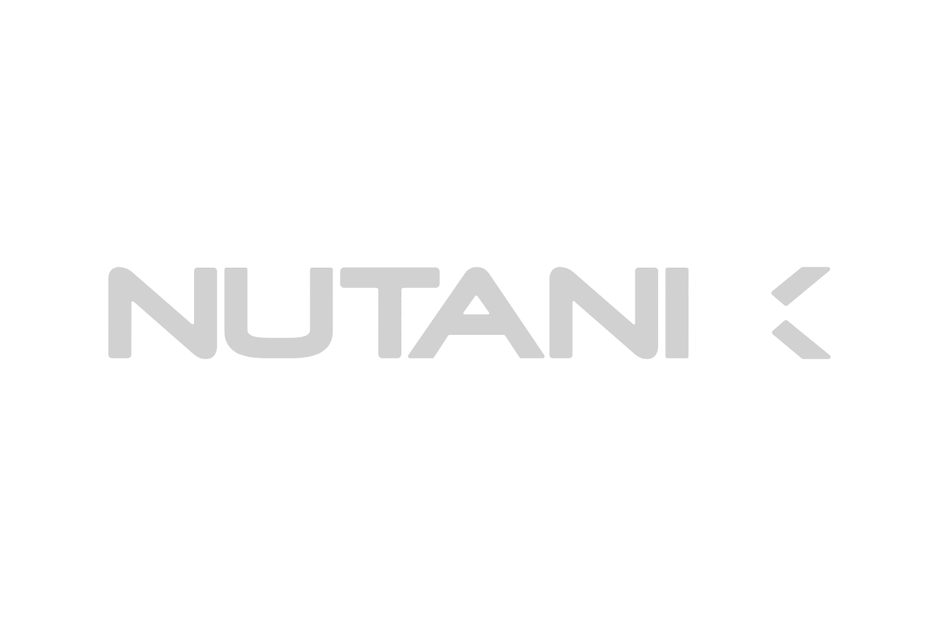



Trusted by Leading Brands
Notes:
Obviously, Salesforce has far more customers than we do!
But we hope this sample of global enterprise brands shows we’re trusted to support large, complex partner ecosystems… and that we’ll take great care of your customers and prospects.

Slide 12
Live Demo
Notes:
SAM
homepage personalization based on SSO directly from SFDC
homepage customization for vendor
assistant AI recommend me an asset/campaign (mention agentforce, agentic piece, partner tracks)
editAI modify asset
translateAI translate
campaign automation/workflow
Social media activation

Slide 13
2026 Vision
Partner Cloud + Structured = Full Partner Lifecycle, Not Just Management Salesforce Partner Cloud gives customers the ability to manage their partner ecosystem, programs, tiers, incentives, and operations. Structured gives them the ability to activate that ecosystem leveraging customized content, campaigns, and AI-led partner engagement.
Together, we deliver the full end-to-end partner experience:
Manage → Activate → Measure → Grow
Seamless SSO + data flow creates a unified story inside Salesforce
Customers get both the operational foundation and the execution engine
AEs can confidently show how partners will actually use Partner Cloud day-to-day
Joint customers see immediate value through activation, adoption, and outcomes
This is the complete partner solution customers expect in 2026.
Notes:
CHRISTINA
Thanks, Sam. Appreciate your time, I have just a few more slides.
As mentioned, Salesforce Partner Cloud already gives customers everything they need to manage their partner ecosystem
Structured comes in is on the activation side. We help your vendors take all of that structure and turn it into real engagement.
Together, we create the complete partner experience that delivers immediate value through activation, adoption, and outcomes.
Salesforce Partner Cloud already gives customers everything they need to manage their partner ecosystem: programs, tiers, incentives, and operations. Where Structured comes in is on the activation side. We help vendors take all of that structure and turn it into real engagement using customized content, campaigns, and AI-driven partner interaction.
Together, we create the complete partner experience: manage, activate, measure, and grow. The integration gives customers a seamless flow of data and a single experience inside Salesforce, and your teams can confidently show how partners will actually use Partner Cloud day to day.
This combined solution is what customers expect in 2026, and it delivers immediate value through activation, adoption, and outcomes.

Slide 14
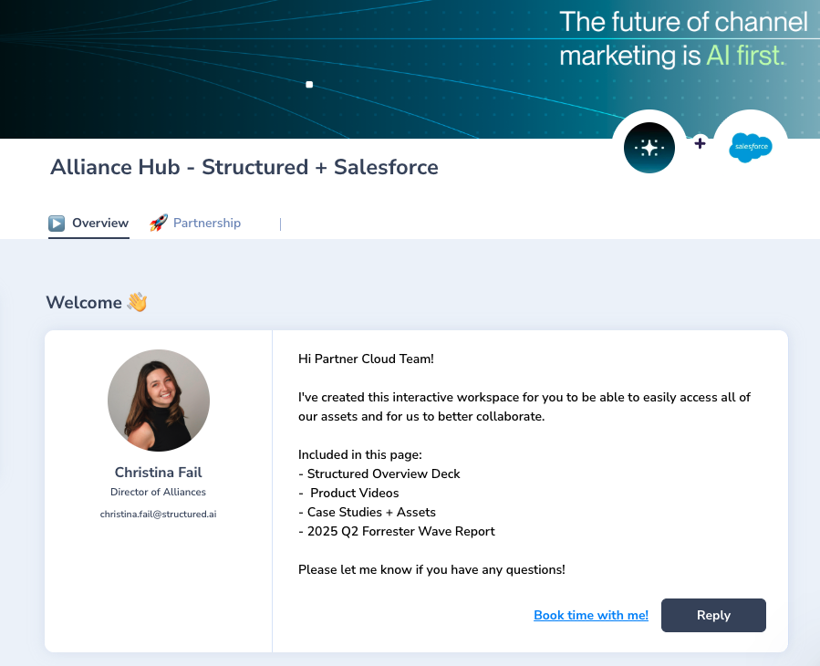
Resources
Salesforce Alliance Hub
Includes:
Contact Information
Structured Overview
Product Videos
Case Studies
Forrester Report
Battle Cards
Joint Marketing
Notes:
CHRISTINA
To make this partnership as easy as possible for you, we built a Salesforce Alliance Hub — essentially a shared deal room where everything you need lives in one place. You’ll find our overview deck, product videos, case studies, the Forrester report, and joint marketing assets. The Forrester report will be a great asset to leverage in the competitive landscape.
As we continue to grow together, we’ll keep expanding this space so you always have the latest materials ready for customer conversations. Think of it as your one-stop shop for anything Structured.

Slide 15
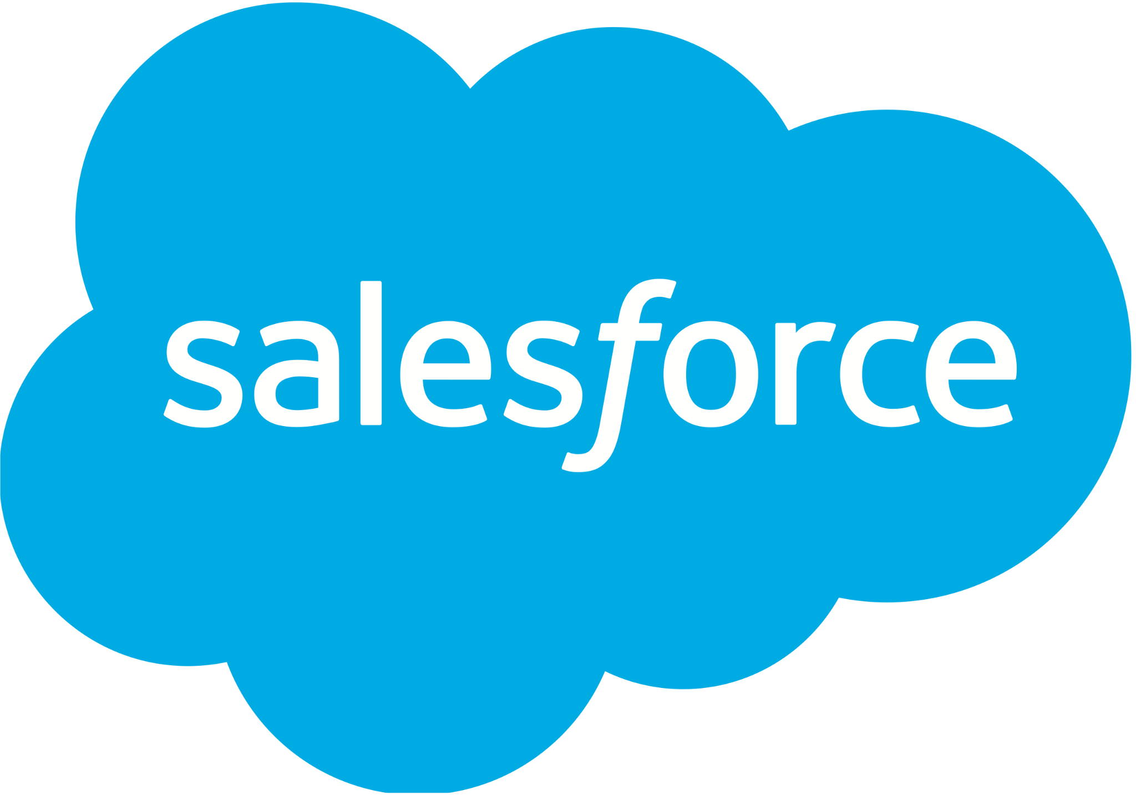
Better Together: Salesforce and Structured
OVERVIEW Structured and Salesforce combine forces to deliver a best in class approach to end to end partner management, activation and execution. Together we use AI to empower partner ecosystems, increase engagement, and accelerate revenue with scalable, repeatable programs that work across every stage of the partner lifecycle.
WHAT IS STRUCTURED? Structured delivers an AI-first, flexible, and easy-to-use platform for partner engagement, activation, and execution. We help enterprise technology vendors scale co-marketing with partners by enabling them to create, customize, translate, and launch content and complete marketing campaigns with full data and analytics.
HOW WE WORK WITH SALESFORCE
We integrate directly with Salesforce via SSO. Partners login once and seamlessly access Structured to launch marketing campaigns. Campaign data flows back into Salesforce, providing closed-loop visibility into ROI.
SALES IMPACT
Structured and Salesforce closed a joint win with KnowBe4, and we’re hoping to add Dynatrace and Genesys next.
HOW TO ENGAGE
We’re here to help Salesforce teams win more. Whether it’s supporting an active deal, strengthening channel strategy, or providing TCMA expertise, Structured complements Partner Cloud to drive more pipeline and revenue.
Notes:
CHRISTINA
So this last slide will live in the deal room, and it just pulls everything together. Salesforce gives customers the partner-management foundation, and Structured brings the activation, the execution, and the measurable results on top of it.
We’ve already closed our first mutual customer, and we’ve got a couple more in the works. And while we don’t have a formal referral agreement, we do reward sellers for referrals.
Once you’re in the room, if anything comes up or you need anything at all, just reach out.
BRIAN
And incase you missed it…all closed referrals will be rewarded handsomely!

Slide 16
Thank You
Notes:
Thank you for your time, and looking forward to partnering together. Are there any questions?

