Slide 1

StructuredWeb Competitive Battle Card Information
Q2 2025 Edition: Forrester Wave + Competitive Intel
May Q2 2025 Edition

Slide 2
Why Now?
StructuredWeb named a Leader in The Forrester Wave™: Partner Marketing Automation Platforms, Q2 2025 report
Highest scores in 11 critical categories, including AI, Roadmap, Innovation, Customization, Personalization, & Localization and more
Zinfi and Mindmatrix also listed as Leaders - time to amplify our market position and widen the gap between us
Unifyr and Impartner were also evaluated - our roadmap, marketing automation focus, and enterprise client roster provides clear competitive separation between us and them

Slide 3

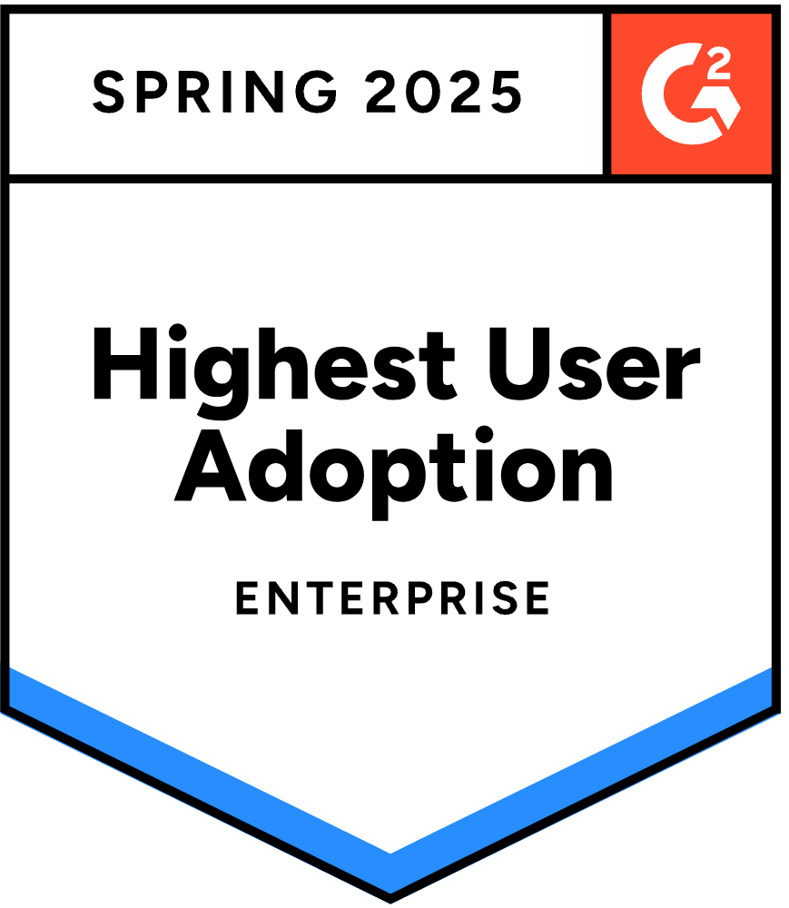

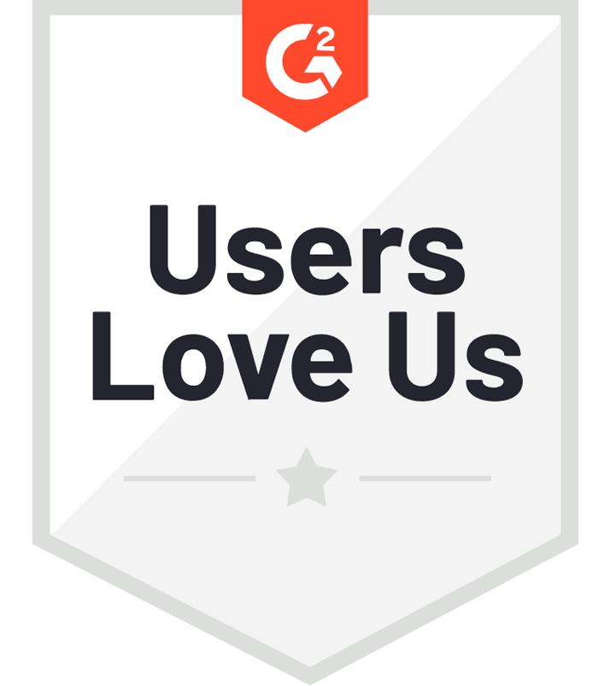
Who We Are
Enterprise clients including Google, IBM, Zoom, Dell, Microsoft, and ServiceNow
25+ years dedicated to partner marketing automation
100K+ partners enabled across 55+ countries
Backed by $30M in growth capital

Slide 4
Why We Win
100% focused on partner marketing automation (no distractions)
AI-first innovation in ChannelGPT
The only marketing automation platform with AI-powered creation, customization, and localization; purpose-built on channel-specific use cases
Smart Journeys and guided workflows enable partner success at all skill levels (campaign execution in just a few clicks)
High user adoption and satisfaction
G2 Users Love Us
Forrester’s Take: “StructuredWeb is a best fit for well-resourced B2B enterprises and distributors looking for a proven, purpose-built PMAP solution.”

Slide 5
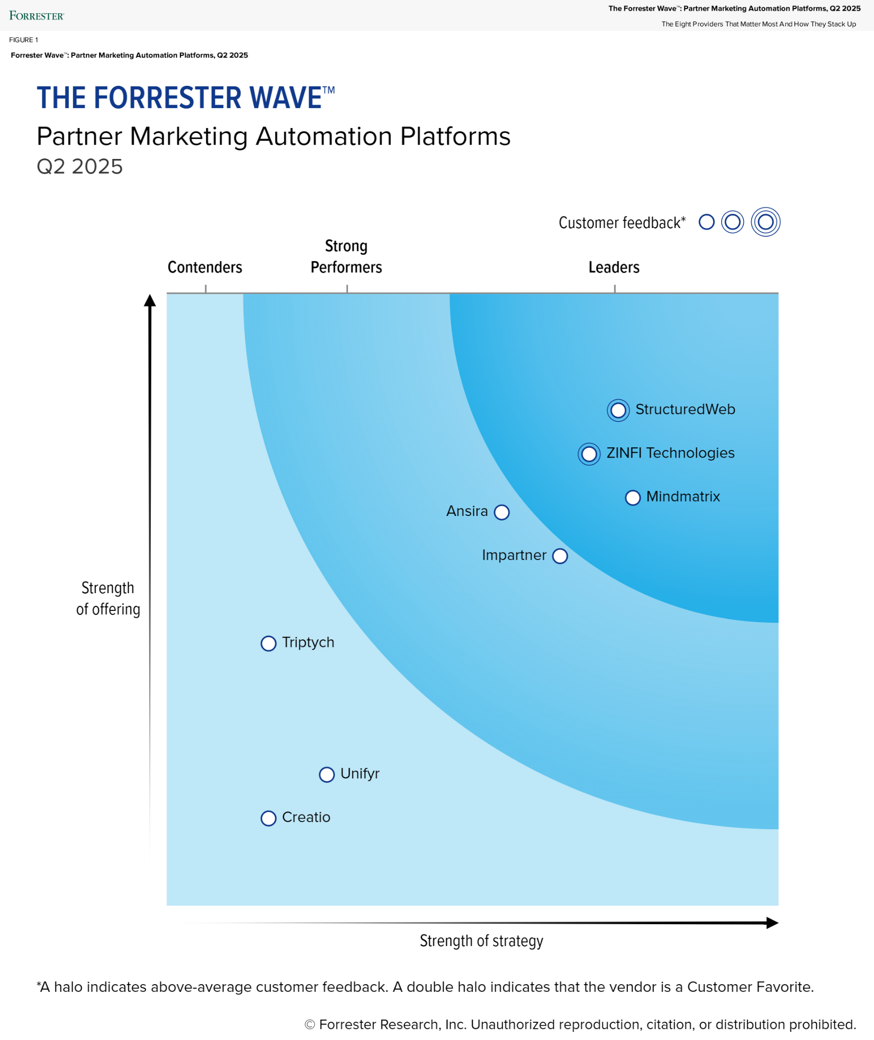
We Lead the Partner Marketing Automation Provider Category
"As the sole vendor in the category dedicated exclusively to B2B partner marketing automation, its [StructuredWeb’s] strategic investments in AI innovation and its 2025 roadmap focus on enhancing the effectiveness of partner marketing automation without diluting resources across a broader portfolio of offerings."
"StructuredWeb is redefining what’s possible in partner marketing." — VP, Global Partner Marketing, ServiceNow

Slide 6



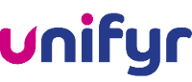

Who We’re Up Against
Zinfi: Unified Partner Management suite (marketing is one part of 6)
Mindmatrix: Combines PRM + Direct Sales Enablement + Marketing
Unifyr (Zift): Rebranded legacy TCMA platform; focused on becoming the “unified” solution for partners selling on behalf of multiple vendors. No clear vision on how this impacts legacy TCMA offering (poor Forrester evaluation)
Impartner: PRM-first vendor attempting to offer partner marketing; lacks depth and scale in marketing automation capabilities
StructuredWeb is the only pure-play B2B partner marketing automation leader with top Forrester scores and exclusive AI innovation

Slide 7
Category | StructuredWeb | ZINFI | Mindmatrix
Focus & Strategy | Solely focused on B2B partner marketing automation; no PRM or incentive distractions. Purpose-built for campaign scale, personalization, and adoption. | Unified Partner Management suite (marketing is 1 of 6 modules). Broader platform spreads focus across PRM, MDF, onboarding, enablement, incentives. | Combines PRM + marketing + direct sales enablement into a unified platform. Orchestrates internal & external sales, but lacks depth in any one area.
AI Innovation | Industry-first generative AI suite: ChannelGPT.AI drives content creation, localization, and campaign recommendations. 100% purpose-built for partner marketing. | Integrates Microsoft Copilot (Azure AI) across platform. AI used for personalization and analytics, but not deeply embedded in marketing automation. | Introduced BridgeAI in 2024. Includes chat assistant and new analytics dashboard. AI use still emerging, focused on content suggestion and Q&A.
Campaign Tools | Best-in-class campaign automation engine. Partners can launch multi-touch, co-branded campaigns across email, social, events, and paid ads. Includes Smart Journeys, Campaign Automator, and Webinar Syndication. | Offers co-op campaign tools and builders within “Market” module. Capable campaign execution but less automated and less intuitive than SW. | Provides basic campaign publishing (email/social). Limited automation and templating. Focus is more on content access than proactive campaign orchestration.
Personalization & Localization | AI-driven personalization by tier, region, and partner profile. Auto-translate into 130+ languages. Partners can localize entire journeys — email, web, video — in minutes. | Offers multilingual support and localized templates. Partners can co-brand and edit content but without real-time or AI-based localization tools. | Supports major languages. Some ability to personalize content by partner, but localization is largely manual. Less focus on personalization at scale.
UX & Partner Adoption | G2 “Highest User Adoption” award. Intuitive UI, guided workflows, and embedded services boost partner use. UI in 19 different languages Actively measures and optimizes adoption. | Modern UI with concierge onboarding. Offers partner portal builder. Adoption is strong, but platform complexity can hinder depth of use for smaller partners. | Functional but more complex. Setup and learning curve noted by users. Relies on hands-on support to drive partner use.
Analytics & Reporting | Deep channel ROI dashboards. Track campaign-level, partner-level, and content-level performance. AI-enhanced reporting

Slide 8
Capability | StructuredWeb | Unifyr (Zift) | Impartner
Core Focus | Pure-play partner marketing automation | Rebranded legacy TCMA suite now marketed as Unified Partner Marketing; lacks innovation depth | PRM-first platform extending into marketing via acquisitions and add-ons
Campaign Automation | Full campaign automation with Smart Journeys, CampaignAI, and partner co-branding tools | Basic co-branding and campaign tools; lacks scale and flexibility | Limited campaign tools; focus is on partner onboarding and enablement, not marketing execution
AI Innovation | Purpose-built generative AI suite: ChannelGPT, TranslateAI, RecommendAI | Minimal; little differentiation noted in Wave | No notable AI-driven marketing features as of 2025
UX & Flexibility | Intuitive interface built for partner usability and global scale; G2 "Easiest Setup" winner | UI carries legacy tech debt; frequent partner complaints | PRM interface well-developed; marketing UI lags and lacks personalization
Ecosystem Fit | Built for enterprise B2B organizations with large, distributed partner ecosystems | Targets SMB to mid-market channel orgs | Best fit for PRM-heavy orgs; not optimized for large-scale marketing ops
Forrester Commentary | Highest scores across Strategy, Innovation, and AI; pure-play leader | Weakest Current Offering score in Leader quadrant | Not evaluated in PMAP Wave; recognized in PRM analysis

Slide 9
Why We Win
vs.
ZINFI covers PRM, MDF, enablement, incentives
Marketing is only one module
AI powered by Microsoft Copilot, not purpose-built
Slower innovation in campaign automation and partner UX

Slide 10
Why We Win
vs.
Mindmatrix splits attention between direct and channel
Smaller customer base, less funding, slower roadmap
Basic AI tools just launched (BridgeAI), content library thin

Slide 11
Why We Win
vs.
Weak performance in 2025 Forrester Wave (lowest Current Offering score of all vendors analyzed)
Tech debt from legacy Zift platform; rebrand doesn't fix core limitations
Lacks modern campaign automation and deep partner personalization
Low innovation score and roadmap compared to StructuredWeb

Slide 12
Why We Win
vs.
Impartner is a PRM-first platform with bolt-on marketing capabilities
Lacks depth in partner marketing automation and AI features
Focused more on deal reg, LMS, and portal than marketing outcomes
Not built for global campaign automation or large-scale personalization

Slide 13

Trusted by Clients, Rated by Users
StructuredWeb: 4.9/5 on G2, "Easiest Setup," "Highest User Adoption"
ZINFI: strong scores but broader, less marketing-focused
Mindmatrix: smaller footprint, limited enterprise validation
Unifyr: mixed reviews, older UI, frequent usability complaints
Impartner: strong for PRM, but customers cite weak marketing capabilities
We are the Leader in Forrester Wave and received above-average customer feedback

Slide 14
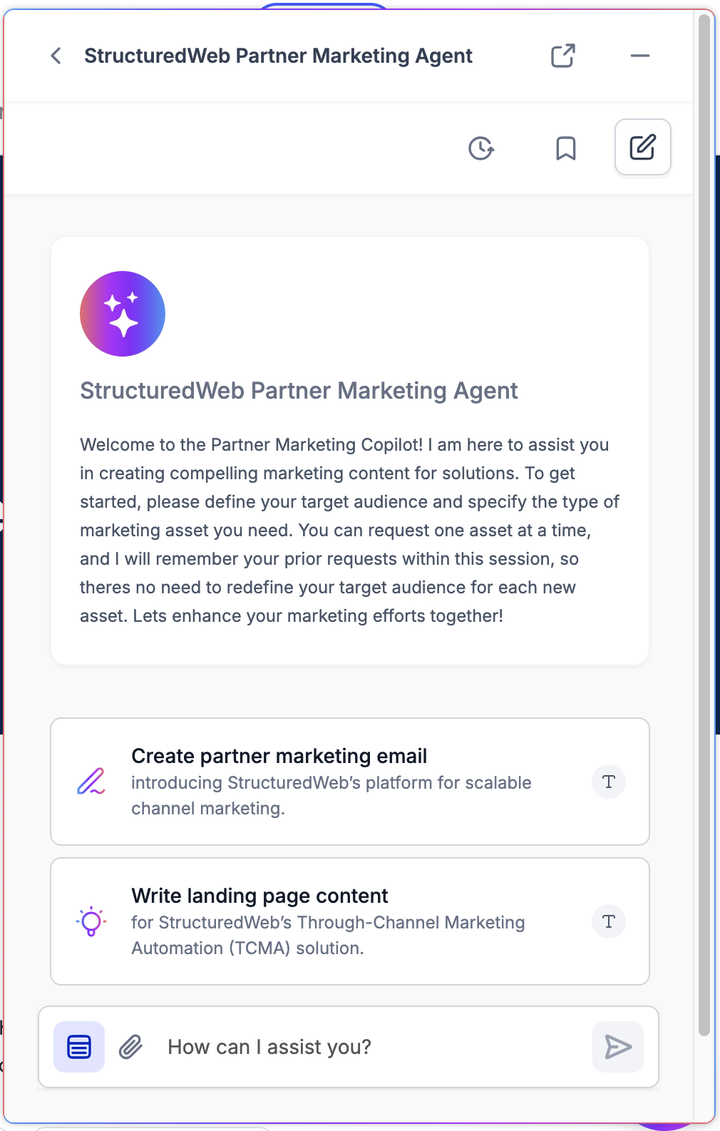
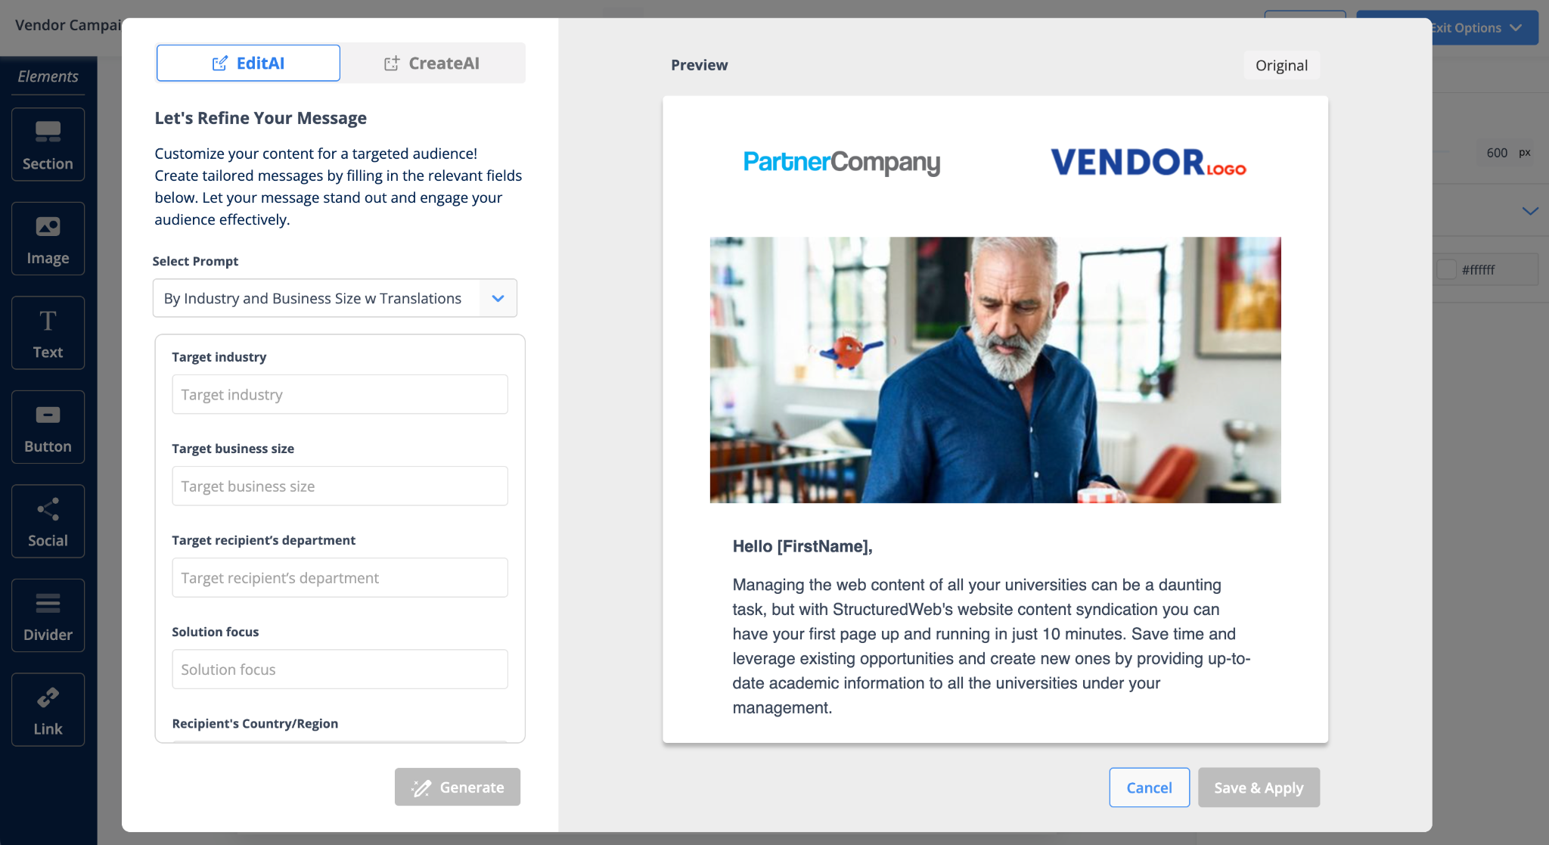
Purpose-Built AI with Real Results
ChannelGPT is the only AI suite trained specifically on channel marketing
Includes predictive/prescriptive content, smart campaign automation, and real-time personalization
Built-in feedback, auditing, and citation tools ensure accountability and partner trust
2025 roadmap focuses on reducing friction, accelerating adoption, and scaling global execution
Why this matters: This reinforces our AI advantage over ZINFI (which uses Azure Copilot) and Impartner (which has no notable AI). It also aligns with Gartner/Forrester’s buyer interest in tailored vs. general-purpose AI.

Slide 15
Fuel to Accelerate
$30M private equity investment secured 2025
Investing in AI, CX, and international expansion
Competitors are bootstrapped (ZINFI, Mindmatrix)
More capital = more innovation, more team growth, and faster scale
Supporting over $100B in partner-driven revenue annually

Slide 16
When We Win
Enterprises with 100+ partners
Organizations prioritizing campaign scale and partner autonomy
Teams frustrated with bundled PRM solutions
Channel leaders ready to uplevel their platform solution, scale globally, and future-proof partner marketing

Slide 17
How to Position Us
"We specialize in what matters most: partner demand."
"Our competitors try to do everything. That’s not always a good thing."
"StructuredWeb delivers faster time-to-value, deeper marketing capabilities, and higher partner usage."

Slide 18
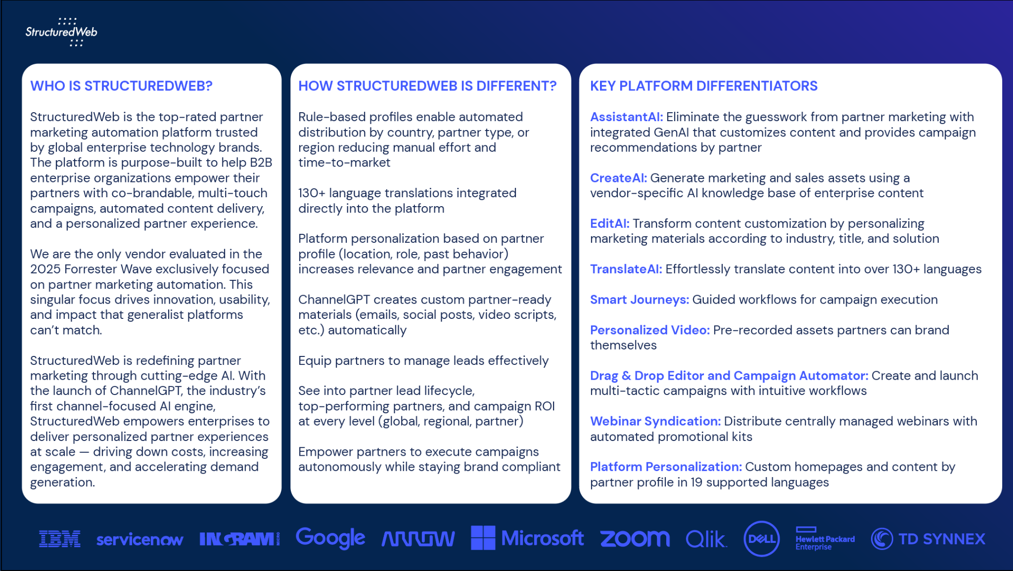
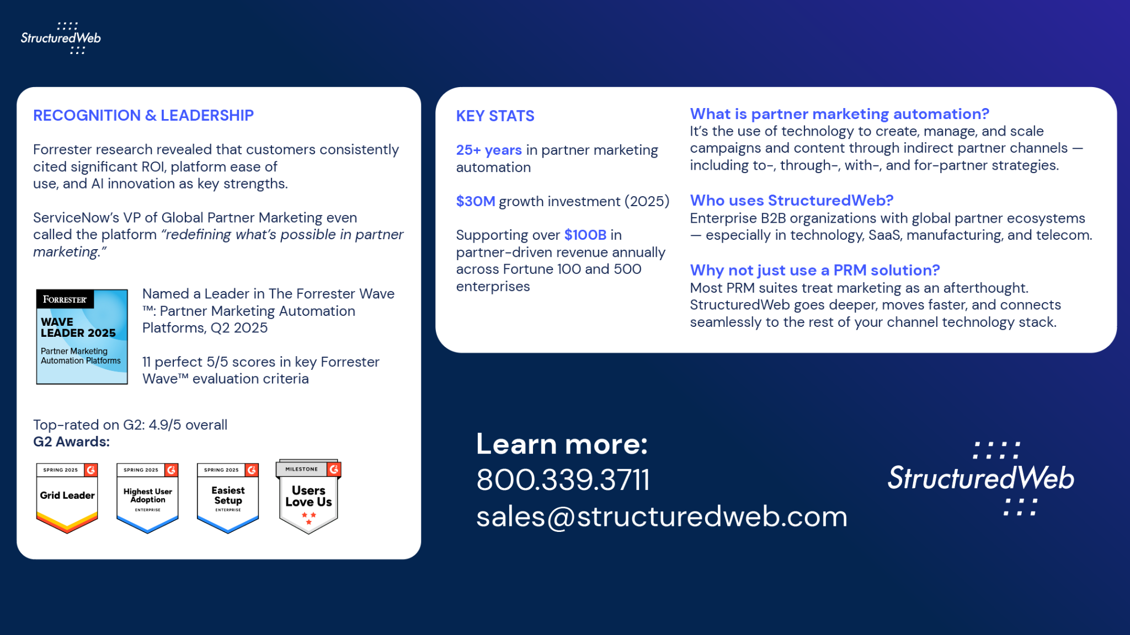
Competitive BattleCard
V2 2025
Download BattleCard

